Slide 1
London’s Air Ambulance Charity
Awareness Week

Slide 2
Introducing London’s Air Ambulance Charity
London’s Air Ambulance Charity delivers rapid response and cutting edge medical care to save lives in the city.
They bring the hospital emergency department to the scene, delivering life-saving treatment to the 10 million people that live and work in London.

Slide 3
Each dispatch
1
MD092 Helicopter or rapid response vehicle
2
Pilots or trained Paramedic driver
1
Specialist Senior Doctor
1
Specially trained Paramedic, also driver for the rapid response vehicle
176 kg
Medical equipment

Slide 4
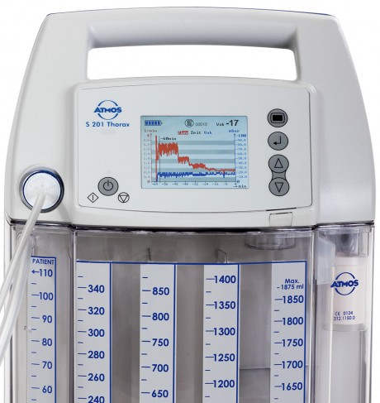
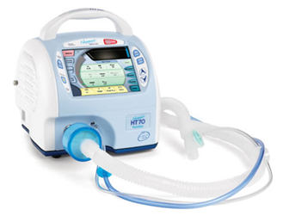
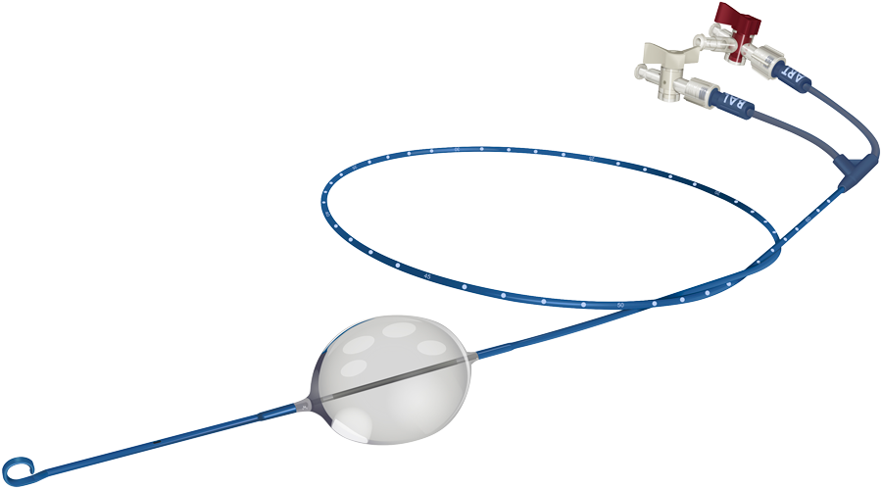
Pre-hospital care

Slide 5
Key figures
5
People on average are treated each day
4
Minutes to ready the helicopter from call to take-off
12
Minutes flight time to anywhere within the M25
1
Hour after an injury to save a life (golden hour)

Slide 6
Mission Map 2021

Slide 7
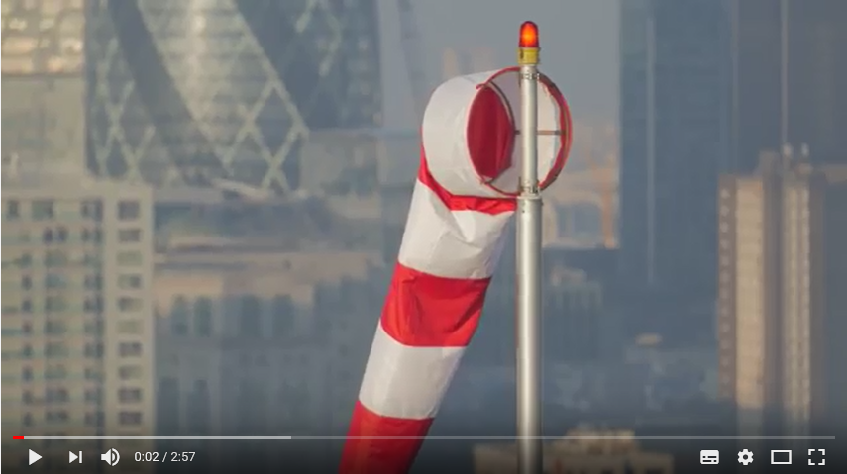
Video of patients

Slide 8
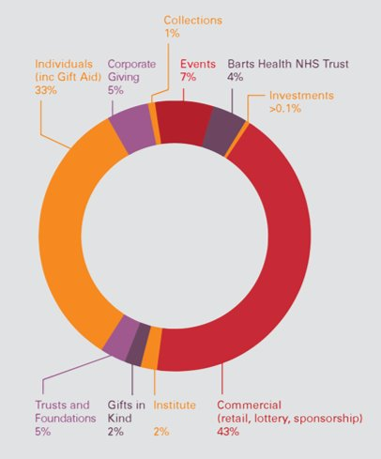
London’s Air Ambulance Income
In 2019-2020 London’s Air Ambulance Charity’s total income was £13.6 million.
The image shows where the money came from.
Can you think of an event that could raise money for London’s Air Ambulance?

Slide 9
London’s Air Ambulance Charity
Awareness Week

