Slide 1
London’s Air Ambulance Charity
Module 1: Helicopter Engineering

Slide 2
In this module, you will learn:
How engineering helps London’s Air Ambulance.
How the design features and materials of an MD902 Helicopter help it to operate.
To understand how the design features of London’s Air Ambulance uniforms help paramedics, doctors and pilots.
Why London’s Air Ambulance uses rapid response cars after dusk and in adverse weather conditions.

Slide 3
Introduction
London’s Air Ambulance uses MD902 Explorer Helicopters. They have been specially engineered and modified to meet the performance requirements of saving lives across the Capital. They are piloted by two pilots and carry a specially trained paramedic and senior doctor as well as all the equipment needed for specialist trauma treatments. One MD902 can be ready to launch in 3 minutes and has an average flight time of 7 minutes. Each vehicle must be up to the job and right on spec for each mission.
Captain Dave Rolfe, Pilot

Slide 4
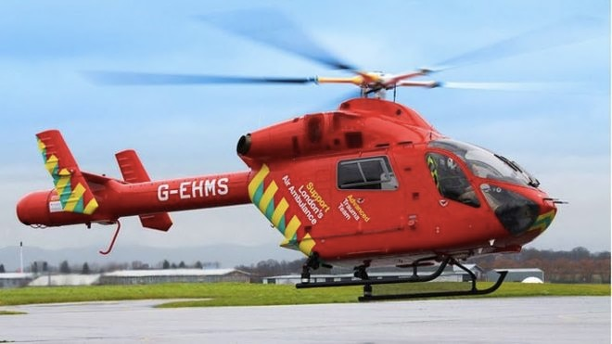
The MD902 Helicopter
Lightweight body of aluminium, carbon fibre composite and polymers
Two engines for safety
Pitot tubes on the nose to measure speed in knots and air temperature
Rotorless tail, for safer flying in urban environments
Space for two pilots, a specialist doctor, paramedic and trainee paramedic
Skids for landing on soft surfaces, made of steel for durability

Slide 5
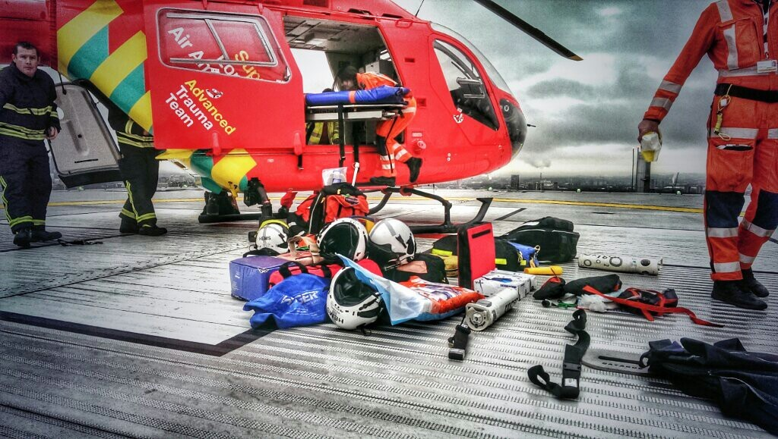
Modified Interior
The interior is specifically modified. It has a medical grade floor for cleanliness, and 176kg of medical equipment including everything needed for open heart surgery, blood transfusions, chest drains and other procedures not normally performed outside of hospital.

Slide 6
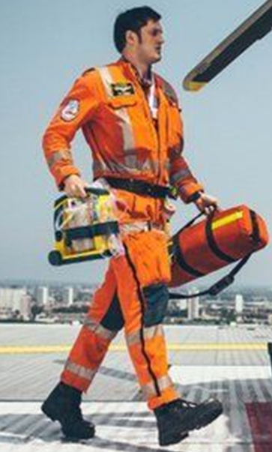
High visibility
LAA insignia
Uniforms
Pilots, paramedics and doctors wear flame retardant, reflective, high visibility nomex jumpsuits that are not only hard wearing but keep them safe, visible and comfortable in dangerous environments.
Steel toe-cap boots are adjustable and quick to put on, whilst an array of loops and belts allow easy carrying of medical equipment.
Kneepads protect the knees and shin whilst doctors treat casualties.
Flame retardant, hard wearing fabric
Custom fitted
Safety harness
Knee
pads
Steel toe-cap boots

Slide 7
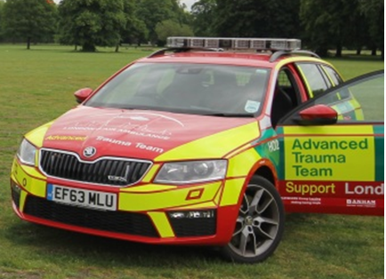
Rapid Response by Road
Blue lights
To ensure 24/7 cover for London, the MD902 helicopter is replaced by high performance Skoda Octavia estate cars after dusk or in adverse weather conditions.
These are navigated by doctors and driven by paramedics after special training for driving in blue light conditions.
2.0 TSI 220PS 6G manual engine
High visibility strips

Slide 8
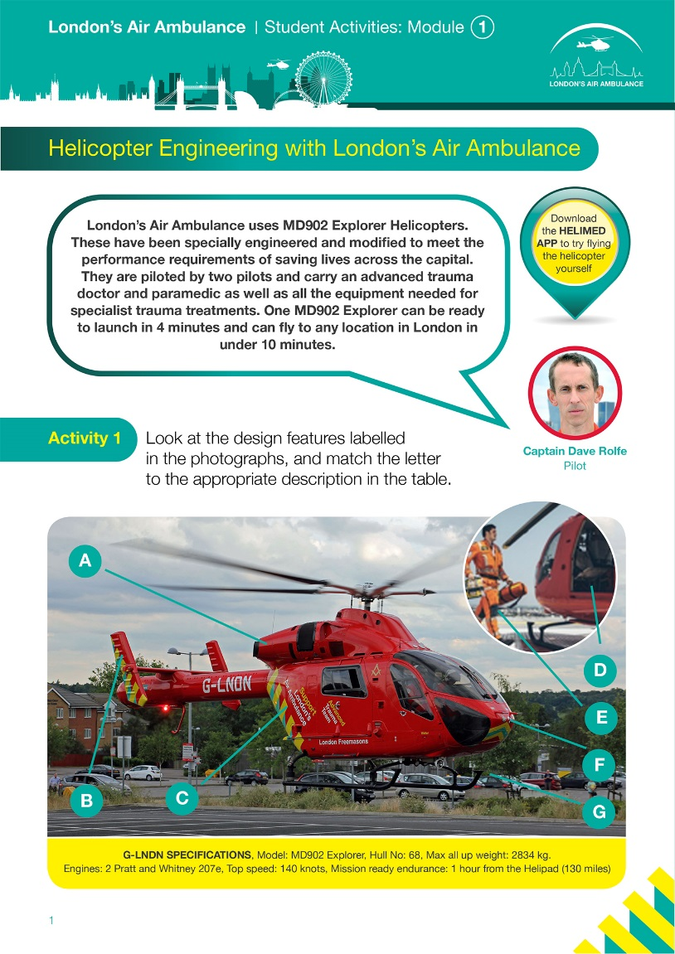
Tasks
Complete the worksheet.
I studied engineering at university, and later trained as a pilot. To study engineering, you should focus on maths, physics and engineering at GCSE and A-Level.
Captain Dave Rolfe, Pilot

