Slide 1
London’s Air Ambulance Charity
Module 2: Navigation

Slide 2
In this module, you will learn:
How London’s Air Ambulance navigates.
How the pilot controls the helicopter in the cockpit.
How to use a map to work out bearings.

Slide 3
Introduction
London’s Air Ambulance uses MD902 Explorer Helicopters that can fly in 11 minutes to anywhere within the M25. London’s Air Ambulance is only deployed when patients have critical injuries and are at risk of death - this means that getting to the patient quickly is very important. Instead of using maps or street signs, we set off from the helipad using bearings. These point us directly to the patient.
Captain Dave Rolfe, Pilot

Slide 4
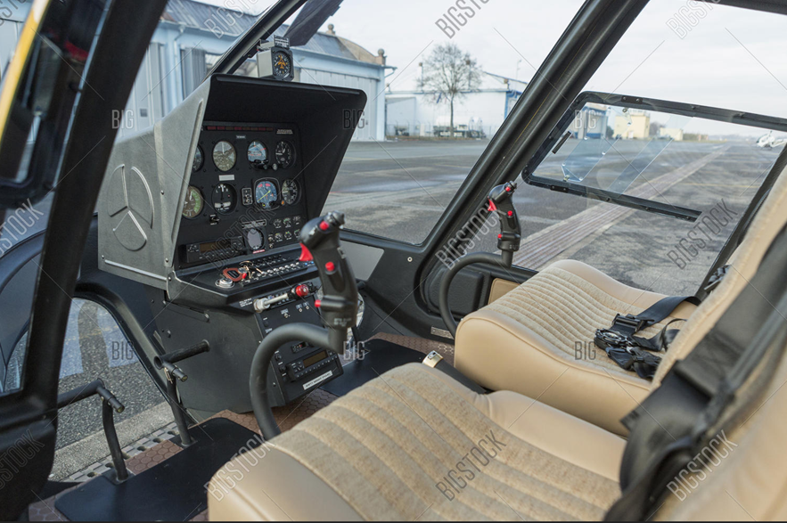
Inside the Cockpit
The cyclic control stick controls the tilt and acceleration in any direction by tilting the rotor blades.
The collective lever changes the angle of all blades together. You can twist the collective lever to control the throttle – this controls the speed of the rotors.
Anti torque pedals can turn the helicopter 360⁰ using the tail.
The control panel and headset also give the pilot all the information that they need to help them fly, including helicopter and wind speed.

Slide 5
Flying with bearings
London’s Air Ambulance uses bearings to direct their helicopters to patients across the capital. A bearing is an angle from 000-360⁰ going clockwise from North at 000^{0.} You can work out the bearing between any two points on a map.
What is the bearing from North for….
East =
South =
West =
North East =
South West =
Remember, always move clockwise from North!

Slide 6
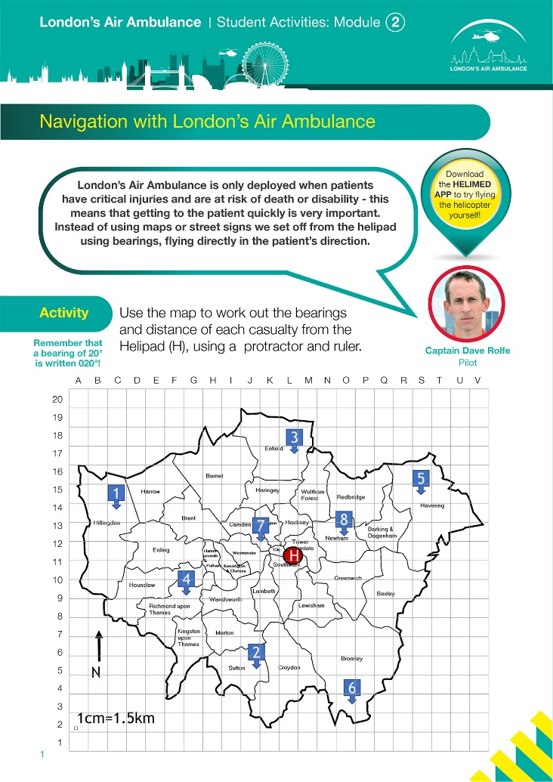
Task
Use the worksheet to find out the bearings of each location across London from the London’s Air Ambulance helipad.
I studied engineering at university, and later trained as a pilot. To study engineering, you should focus on maths, physics and engineering at GCSE and A-Level.

