Slide 1
London’s Air Ambulance Charity
Module 3: Financing

Slide 2
In this module, you will learn:
How London’s Air Ambulance is funded.
How to use percentages to work out real-life number problems.
How to calculate the amount of fuel used in an average London’s Air Ambulance mission.

Slide 3
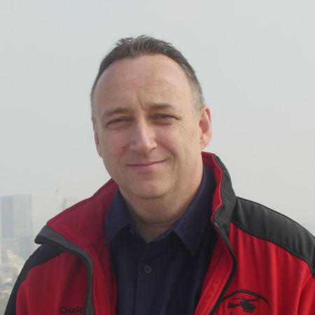
Introduction
London’s Air Ambulance is a charity, relying heavily on donations. In 2015/2016, we increased our income by 12.4%, and after a successful fundraising campaign we managed to buy a second helicopter, which was operational in January 2016, and allowed us to fly extended hours. We receive some funding from the Government, but mostly rely on people and businesses donating and raising funds for us. When someone simply donates to us, organises a cake sale or runs a marathon for us, it helps us save lives in London.
Jonathan Jenkins, CEO

Slide 4
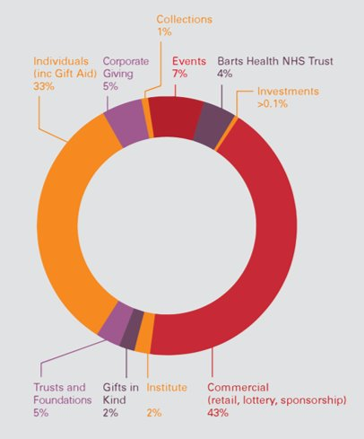
Analysing Income
This is a breakdown of London’s Air Ambulance Charity’s income between 2019-2020.
From which funding stream does London’s Air Ambulance get most of its income?
From which funding stream does London’s Air Ambulance get the least income?
What percentage of its income come from events?
Can you think of an event that could raise money for London’s Air Ambulance?

Slide 5
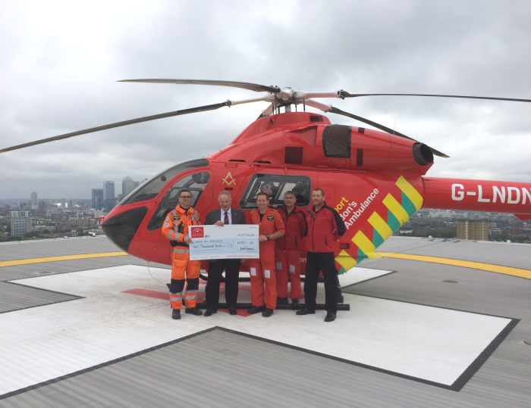
Task: Raising Funds
London’s Air Ambulance relies heavily on individual donations and other income streams, including support from businesses and schools. You might be raising money at your school!
In your groups, you have 5 minutes to come up with as many fundraising ideas as you can.
You can present your ideas as a mind map.

Slide 6
Calculating Income
We can use a calculation to work out the income for each sector in pounds (£).
Total income was £13 million in 2019-2020.
Corporate Giving makes up 5% of the total income.
(13,000,000 100) x 5 = 650,000
= £650,000
How much is 1%?

Slide 7
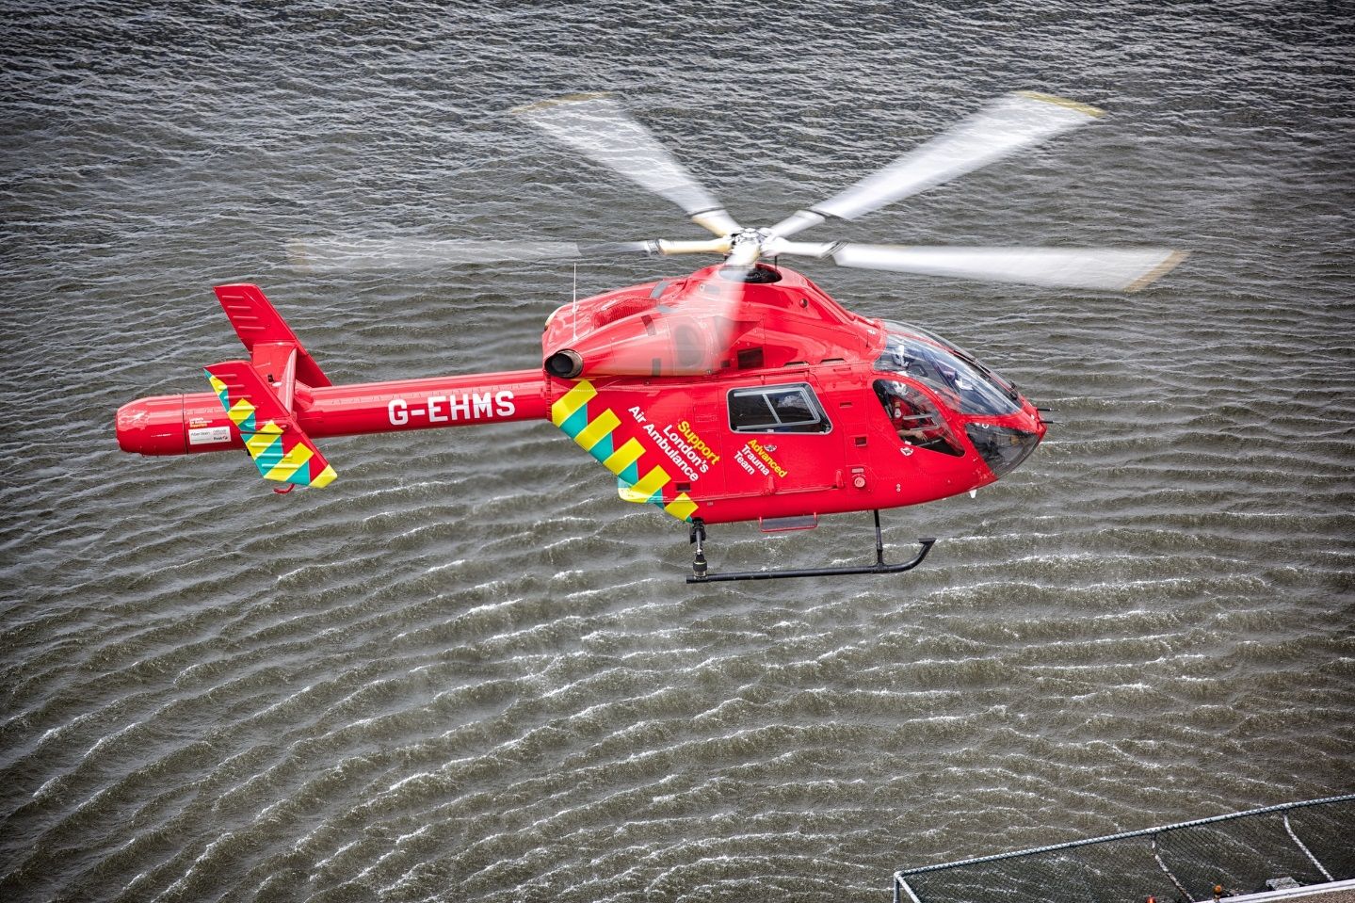
Outgoings
One of the many costs involved is fuelling the helicopters. No fuel is kept on site at the Helipad for safety reasons, however London’s Air Ambulance can refuel at various locations across the capital.
Question:
If 1 litre of fuel is used up every 10 seconds, how much fuel is needed for a journey of 7 minutes?

Slide 8
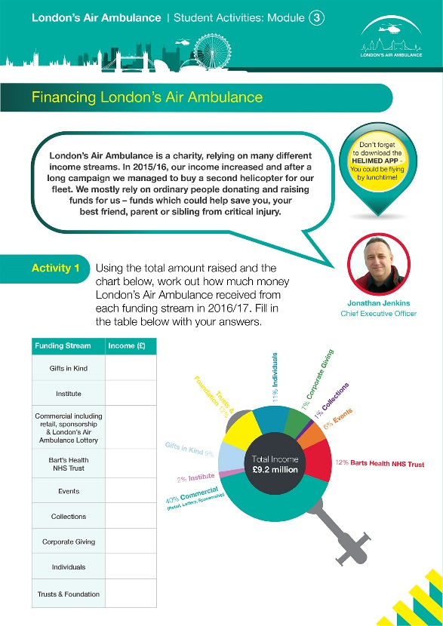
Task
Use the worksheet to analyse the income and costs involved in operating London’s Air Ambulance.
You don’t have to be a doctor or paramedic to help London’s Air Ambulance. There are many ways to support us. Why not host a fundraising event at your school, or run a London’s Air Ambulance Week?

