Slide 1
London’s Air Ambulance Charity
Module 4: Medical Biology

Slide 2
In this module, you will learn:
What types of care are provided by London’s Air Ambulance.
About the organs and tissues that help us to breathe and circulate oxygen.
About the specialist equipment carried by London’s Air Ambulance.

Slide 3
Introduction
As an advanced trauma doctor at London’s Air Ambulance, I can perform complex medical procedures at the roadside. I bring the hospital to the patient’s side when every minute counts. I have the equipment and medicine to administer anaesthetic and perform open chest surgery anywhere it is needed - procedures normally only carried out in the hospital’s Emergency Department. This can save lives.
Dr Gareth Davies, Advanced Trauma Doctor

Slide 4
Pre-hospital Care
How London’s Air Ambulance patients were injured (2018)
London’s Air Ambulance delivers advanced trauma care to critically injured people – patients at serious risk of death or disability.
This ‘pre-hospital’ care is often for patients with critical injuries to their circulatory or respiratory systems.
On average, 5 patients each day are treated by London’s Air Ambulance.
Road traffic collisions | 469
Stabbings & shootings | 485
Falls | 346
Other (e.g. drownings) | 356
Total | 1656

Slide 5
Circulatory System
Your circulatory system consists of your heart as well as your veins, arteries and capillaries, taking oxygenated blood from the lungs in arteries to every cell in your body for respiration. Severe bleeding could cause a lack of oxygen to the brain and over 40% blood loss could cause death.
London’s Air Ambulance carry the equipment not only to perform open heart surgery (thoracotomy), to fix the punctured heart and perform heart massage, but they also carry a blood transfusion kit and a special balloon to plug broken arteries and stop patients bleeding to death – a procedure call REBOA.

Slide 6
Respiratory System
The respiratory system is vital to providing the oxygen needed for you to survive. As the diaphragm and intercostal muscles pump air in through the trachea, it splits at the bronchi, and then brands off into the bronchioles. Oxygen then enters the blood at the air sacs.
A punctured lung or a broken rib cage from a fall or car accident could be fatal. London’s Air Ambulance can install a chest drain to remove trapped air or leaked blood from the pleural cavity, as well as provide artificial breathing through a ventilator.
Notes:
.

Slide 7
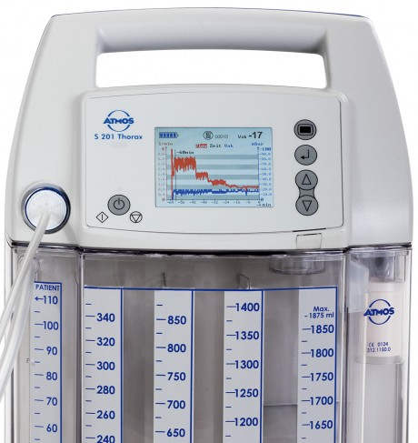
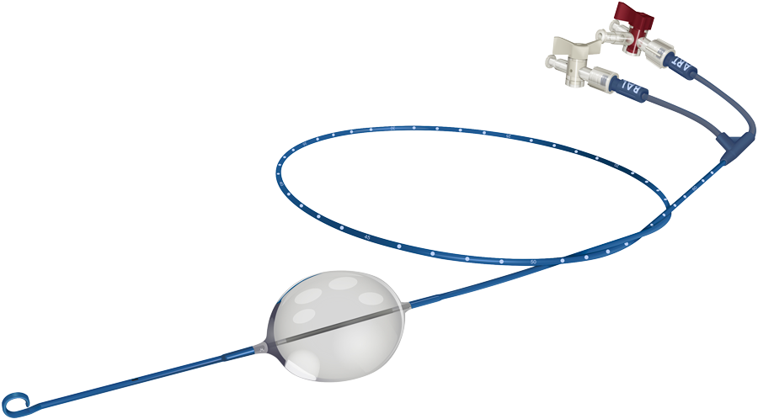
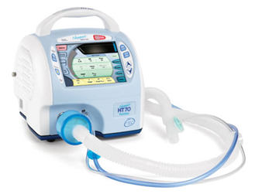
Specialist Equipment
Can you remember what each piece of equipment is used for?
REBOA
(Resuscitative Endovascular Balloon Occlusions of the Aorta)
Chest Drain
Ventilator

Slide 8
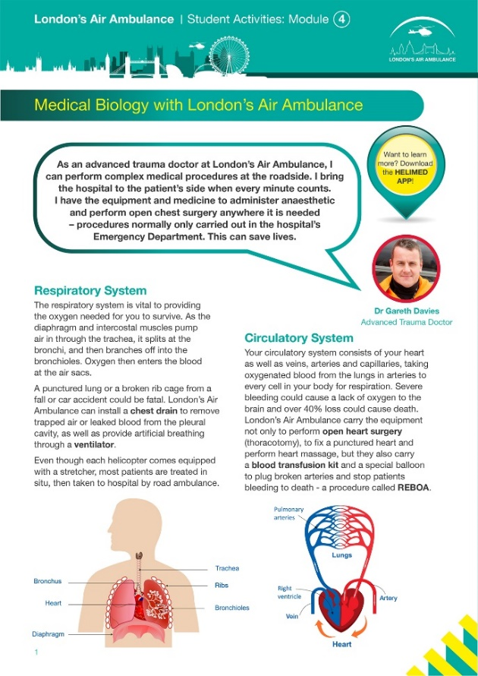
Task
Answer the questions on the sheet about organ systems and specialist treatments
To become a doctor you need to study medicine at university. Many courses require you to have studied A-Level chemistry and sometimes biology. You will also need to have completed relevant work experience or volunteering such as working with the elderly or helping in a GP surgery or care home.

